Slide 1
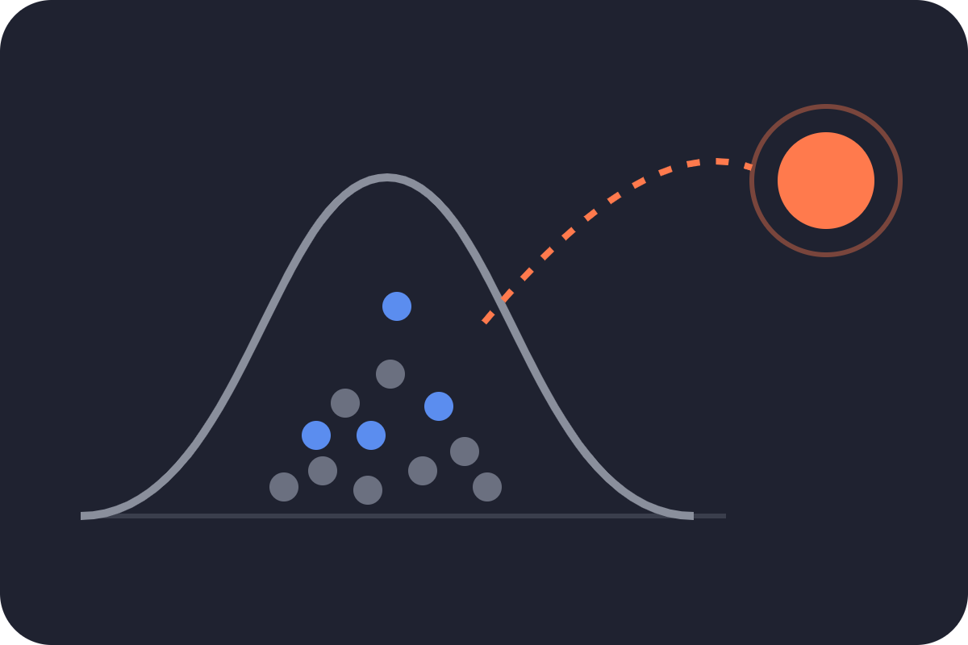
Outliers
INVESTOR BRIEFING · CROWDFUNDING ANALYTICS
Founders and funders, meet the
Proudly three standard deviations from the mean.
Will your Kickstarter get funded? Predicting success before launch day
We don’t fit the curve. We fund it.
We are a data team that hunts for the patterns most people average away. We read 378,661 crowdfunding campaigns so you don’t have to.
Presented by Outliers · Daniel Chercos, Diego de Castro Lopez, Max Thormann, Firas Harb, Javier Yturriaga 23 Oct 2026
Notes:
Welcome. We're Outliers. Our tagline says we're two standard deviations from the mean, which is statistician for "we stand out, in a good way." Today: can you tell, before a Kickstarter campaign launches, whether it will get funded? We worked through 378,661 campaigns to find out. The funded ones are the outliers, just like us. And yes, the potato-salad joke is real: a viral 2014 joke campaign set off hundreds of copycats, which we removed in cleaning. We were not.

Slide 2
Most campaigns miss and get nothing
01 · THE OPPORTUNITY
Crowdfunding 101
What we built
36.4%
Many backers pledge small amounts to fund an idea
Kickstarter is all-or-nothing: miss the goal, get $0
Our data: 378,661 Kickstarter projects, 2009 - 2018
A Gradient Boosting model, tested against 3 benchmarks
Predicts funding before launch
funded, of 366,690 cleaned projects 63.6% miss and receive nothing
Problem
Who it serves
Value proposition
Most campaigns fail (63.6% not funded)
Founders and backers commit time and money with no early read on the odds
Founders planning a launch
backers, buyers and platforms screening ideas
A pre-launch risk check
Funders: Flags weak setups while they can still change
Backers: rank projects fast before diligence
Funding platforms: Use it as add-on
Outliers · Will your Kickstarter get funded?
2 / 12
Notes:
Animation: the top row builds in by itself (crowdfunding basics, what we built, then the 36.4% card pops in). Click once to bring in the bottom row (problem, who it serves, value proposition). Quick primer: crowdfunding means raising money from many people who each pledge a small amount, usually in exchange for rewards. Kickstarter is all-or-nothing: if the goal isn't reached by the deadline, the founder receives nothing. Only about one in three projects gets funded. Our Gradient Boosting model gives an early read using only information known at launch. Be clear with investors: market size means how many founders, investors or platforms would pay for this, and our files don't measure it. Product form means how the model is packaged, for example a web app for founders or a screening tool for platforms; that is our idea and hasn't been tested with users. Both are what an investment would help validate.

Slide 3
From raw file to model-ready data
02 · DATA FOUNDATION
Before: the raw file
After: model-ready
ks-projects-201801.csv (2009–2018)
kickstarter_final.csv
378,661 projects × 15 columns
6 outcome states: failed 52%, successful 35%, canceled 10%, live / undefined / suspended 2%
Pledged $ and backers: known only after the campaign
Goal in 14 currencies, $0.01 to $166M, heavily skewed
Messy rows: missing names, broken country codes, 1970 dates, re-posts, jokes
366,690 projects (96.8% kept) × 14 columns
One yes/no target: 1 = funded, 0 = not funded
11 features known at launch: 5 numeric, 6 categorical
New: campaign duration and goal vs category
Goal in USD on a log scale; outliers kept, no missing values
Imbalanced target
Always guessing “not funded” is already 63.6% right, so we judge models with ROC-AUC and F1, and keep this ratio in every train/test split.
36.4% funded
63.6% not funded
133,652 projects
233,038 projects
Outliers · Will your Kickstarter get funded?
Notes:
On the left, the file as we got it: almost 379,000 projects with six possible outcomes, columns that are only known after the campaign ends, a goal in 14 currencies, and messy rows. On the right, what we model with: 366,690 projects, so we kept 96.8%, a single yes/no target, and 11 features that a founder knows on launch day, two of them engineered by us. The strip at the bottom is important for how we evaluate: only 36.4% of projects were funded. That is a moderate imbalance: a model that always says 'not funded' is already right 63.6% of the time, so accuracy alone would flatter any model. We use ROC-AUC and F1 instead, and every train/test split keeps the same 36/64 ratio. The imbalance is not extreme, so we did not need resampling.

Slide 4
From 6 outcome states to a yes / no target
02 · DATA FOUNDATION
Original state | Projects (raw) | Decision | Why
Successful | 133,956 (35.4%) | Kept → 1 | Reached its goal: funded
Failed | 197,719 (52.2%) | Kept → 0 | Missed its goal: not funded
Canceled, under 50% of goal | 36,696 | Kept → 0 | Heading for failure: 76% of canceled had under 10% of their goal, and a model sees them like failed ones
Canceled, 50%+ of goal | 2,055 | Dropped | Could have gone either way; some had already reached the goal
Live | 2,799 (0.7%) | Dropped | Still running: no final outcome yet
Undefined | 3,562 (0.9%) | Dropped | Outcome unknown
Suspended | 1,846 (0.5%) | Dropped | Stopped by Kickstarter for rule breaks (e.g. suspected fraud), not by backers
Other cleaning (any state) | 1,713 | Dropped | 245 missing values · 687 quick re-posts · 781 joke / test projects
Final: funded | 133,652 (36.4%) | Target = 1 | Successful projects left after all cleaning
Final: not funded | 233,038 (63.6%) | Target = 0 | 197,076 failed + 35,962 canceled under 50% of goal
Outliers · Will your Kickstarter get funded?
Notes:
The raw file has six outcome states, and we turned them into a single yes/no target. Successful projects are 1, failed projects are 0. Live projects were still running when the data was collected, so their outcome is unknown; even the ones already funded could still lose backers. Undefined projects have no known outcome at all. Suspended projects were stopped by Kickstarter itself for breaking its rules, for example suspected fraud or no working prototype; some had already raised far more than their goal, so suspension says nothing about funding. Canceled projects were the hard decision. We have no cancellation date, but we know how much was pledged when they stopped: 76% had less than 10% of their goal. A model trained only on successes and failures scores them exactly like failed projects, so we count those under 50% of the goal as not funded. The 2,055 that had 50% or more could have gone either way, or were stopped despite being funded, so we dropped them rather than guess.

Slide 5
Features: leakage out, redundancy out, signal in
02 · DATA FOUNDATION
Leakage: the strongest columns had to go
Feature engineering: new features
Campaign duration (deadline − launch): 30-day campaigns 32% funded, 60-day only 19%.
Goal vs category Makes goals comparable across categories; boosted our simpler model.
Name length Certain correlation with outcome
Pledged and backers were the most predictive columns, but they are only known after the campaign ends. Pledged ≥ goal is the definition of success (matches 99.997%).
Quick model check, ROC-AUC (1.0 = perfect):
Redundant columns dropped
Goal + duration
0.67
Main category (15 groups; category, 159, is more detailed) · currency (country explains it) · goal in local currency (USD kept) · ID.
+ backers
0.98
+ pledged $
0.9999
Kept in, they make the model look perfect but useless before launch. Without them, launch-time facts alone are weak (0.67), so we engineered more signal.
Outliers kept, goal on a log scale
Goals run from $0.01 to $166M. log10 makes them near-symmetric; the extremes are real and informative: under $10, 79% funded; $10M+, 0%.
Outliers · Will your Kickstarter get funded?
Notes:
The most predictive columns in the raw file were pledged, usd pledged, usd_pledged_real and backers. The problem is that they are only known after the campaign ends: pledged at or above the goal is the definition of success, it matches 99.997% of the time. A quick model check shows it: goal and campaign length alone score 0.67 ROC-AUC; adding backers jumps to 0.98 and pledged dollars to 0.9999. A model with them looks perfect but is useless for a founder before launch, so we removed them. What is left is much weaker, so we engineered features to add signal: campaign duration, and how ambitious the goal is compared with the typical goal in its category. Both show clear patterns. We also dropped columns that add nothing new: main category is a coarser version of category, currency is almost fully explained by country, and the goal in local currency is replaced by the goal in US dollars. Finally, outliers: goals range from one cent to 166 million dollars. We kept them, because the extremes are real and very informative, and put the goal on a log scale instead.

Slide 6
Our model: Gradient Boosting
03 · METHODS
Baseline
Logistic Regression
Random Forest
OUR MODEL
Always predicts “not funded”.
One weighted formula over all factors.
100 decision trees vote on the outcome.
Gradient Boosting
Benchmark: the bar to beat. 63.4% accurate, yet finds zero successes (validation).
Trees built in sequence, each fixing the last one’s errors.
Benchmark: simple and transparent.
Benchmark: catches non-straight-line patterns, like goal thresholds.
Why: often strongest on table-style data like this.
How we kept it honest
Group-aware split
The right scorecard
Fair tuning
68% train, 12% validation, 20% test (249,365 / 44,010 / 73,315). Relaunches of one project stay on one side.
F1 balances precision (success calls that are right) and recall (successes found). ROC AUC: 0.5 = coin flip, 1.0 = perfect.
38 settings tried on validation only (8 LR, 18 RF, 12 GB). The test set was used once, at the end.
Outliers · Will your Kickstarter get funded?
4 / 12
Notes:
Gradient Boosting is our model. The other three exist only as benchmarks: a do-nothing baseline, a transparent logistic regression and a random forest. They show how much Gradient Boosting adds and whether a simpler model would do. Successful projects get extra weight (balanced class weights) because they are the minority. We use F1 rather than accuracy because a model that always says "fail" is already about 64% accurate while being useless. The group-aware split prevents a relaunched project from appearing in both training and test.

Slide 7
Gradient Boosting beats every benchmark
04 · BENCHMARKING OUR MODEL
What it shows: validation scores of each model’s best-tuned version (training notebook, “Comparison of the Best Models”). Bars start at 0.
How our model compares
Gradient Boosting (our model): best on every metric (F1 0.6245, AUC 0.7617; best setting: learning rate 0.1, 63 leaves).
F1 score (higher = better balance of hits and misses)
Gradient Boosting
0.6245
Random Forest
0.6133
Random Forest (benchmark): close second (F1 0.6133, AUC 0.7481; deeper trees helped, depth 20).
Logistic Regression
0.5885
Baseline
0.0000 (finds no successes)
Logistic Regression (benchmark): weakest but most transparent (F1 0.5885). Weighting successes mattered far more than other tuning (F1 0.4803 unweighted vs 0.5885 weighted).
ROC AUC (0.5 = coin flip, 1.0 = perfect ranking)
Gradient Boosting
0.7617
Random Forest
0.7481
So what: our model leads, but the benchmarks land close (F1 0.59–0.62), so the limit is the data, not the algorithm.
Logistic Regression
0.7242
Baseline
0.5000
Outliers · Will your Kickstarter get funded?
5 / 12
Notes:
All numbers are validation-set scores from the "Comparison of the Best Models" table. Gradient Boosting is our model; the other three are benchmarks. It beats all of them on every metric, which is why it was selected and retrained as the final model. The gaps are small, which the notebook interprets as a ceiling set by the available features. For logistic regression, the regularization strength C made no difference; turning on balanced class weights was what lifted F1.

Slide 8
Right about 2 in 3 times, and stable
05 · FINAL MODEL ON UNSEEN PROJECTS
What it shows: Gradient Boosting scored once on 73,315 held-out test projects (training notebook, “Final Model and Test Evaluation”)
F1
ROC AUC
Recall
Precision
Accuracy
0.621
0.758
0.717
0.548
0.681
vs 0.00 for the baseline
well above a coin flip (0.5)
finds ~7 in 10 funded projects
of “success” calls are right
vs 0.636 for “always fail”
No overfitting
Dial the caution up or down
Training and test scores differ by about 0.01 on every metric (F1 0.631 train vs 0.621 test; AUC 0.771 vs 0.758), so it should behave the same on new projects from this population.
Cut-off for “success” | Precision | Recall | F1
0.50 (default) | 0.548 | 0.717 | 0.621
0.60 | 0.606 | 0.546 | 0.575
0.70 | 0.677 | 0.334 | 0.447
It leans optimistic: it finds most winners but over-calls success (recall 0.717 vs precision 0.548).
Illustrative only: computed on the test set, so not used for the reported result.
Outliers · Will your Kickstarter get funded?
6 / 12
Notes:
Plain language: out of every ten funded projects, the model spots about seven. When it says "this will fund," it is right a bit more than half the time. Accuracy of 68% looks modest next to the 64% baseline, but the baseline never identifies a single success. Raising the cut-off makes the model more cautious: higher precision, fewer successes found. A founder wanting a reliable warning and a platform wanting to spot promising projects would pick different cut-offs.

Slide 9
Goal and category matter most
06 · WHAT DRIVES SUCCESS
What it shows: importance of individual features to our model.
Funding goal
0.090
Goal is #1: lower goals win (slide 8).
Category
0.072
Campaign length
0.031
Category is #2: some categories fail much more often than others.
Launch year
0.024
Name length
0.015
Launch hour
0.010
Timing barely matters.
Country
0.006
What you build and ask for beats when you launch.
Launch month
0.005
Launch weekday
0.003
Goal vs. category
0.002
Day of month
0.002
Outliers · Will your Kickstarter get funded?
7 / 12
Notes:
Permutation importance asks: if we scramble this one piece of information, how much worse does the model get? Scrambling the goal costs the most, then category. Important caveat: this tells us what the model relies on, not what causes success. Slide 9 shows the per-category rates: music and performance lead (Dance 67%), tech trails (Apps 6%).
Goal vs. category (the goal compared with the typical goal of its category) is one of the weakest features. That does not mean the comparison is useless: the model already gets it from the goal and the category, so the extra feature is redundant. Validation F1 was 0.6245 without it and 0.6248 with it.

Slide 10
Smaller goals get funded far more often
07 · KEY FINDING: THE GOAL
What it shows: share of projects funded, by funding goal in USD. Blue = above the overall 36% success rate, orange = below.
79%
57%
51%
42%
27%
8.6%
1.4%
0%
< $10
$10–99
$100–999
$1k–9.9k
$10k–99k
$100k–999k
$1M–9.9M
$10M+
n=610
n=2,777
n=42,347
n=178,872
n=126,323
n=14,408
n=1,173
n=180
Outliers · Will your Kickstarter get funded?
8 / 12
Notes:
The single clearest pattern in the data. Success falls steadily as the goal rises: 42% for $1,000 to $9,999, 27% for $10,000 to $99,999, under 9% for six-figure goals, and not one project with a goal of $10 million or more was funded. This is a raw success rate, not a controlled experiment: big-goal projects may also differ in other ways. Still, for founders, the goal is the most powerful lever they control.

Slide 11
Music and performance thrive, tech struggles
08 · KEY FINDING: THE CATEGORY
Share of projects funded. Blue = above the 36% average, orange = below.
overall 36%
Dance
66.8%
Top 3: music and dance, ~65%.
Indie Rock
64.3%
Bottom 3: all tech, 6–12%.
Classical Music
63.8%
Software
12.4%
Dance is 11× more likely to be funded than Apps.
Web
8.8%
Apps
6.1%
Outliers · Will your Kickstarter get funded?
9 / 13
Notes:
Success rate by category, from the EDA notebook (section 19 chart), over 53 categories with "Other" left out. The top 3 are Dance (66.8%, n=2,307), Indie Rock (64.3%, n=5,623) and Classical Music (63.8%, n=2,583); Country & Folk and Theater follow at about 63%. The bottom 3 are Software (12.4%, n=2,993), Web (8.8%, n=5,036) and Apps (6.1%, n=6,213). Every group has more than 2,000 projects, so these are not small-sample flukes. Caveat: these are raw rates. Tech projects also tend to ask for bigger goals, so part of the gap is the goal effect from slide 8.

Slide 12
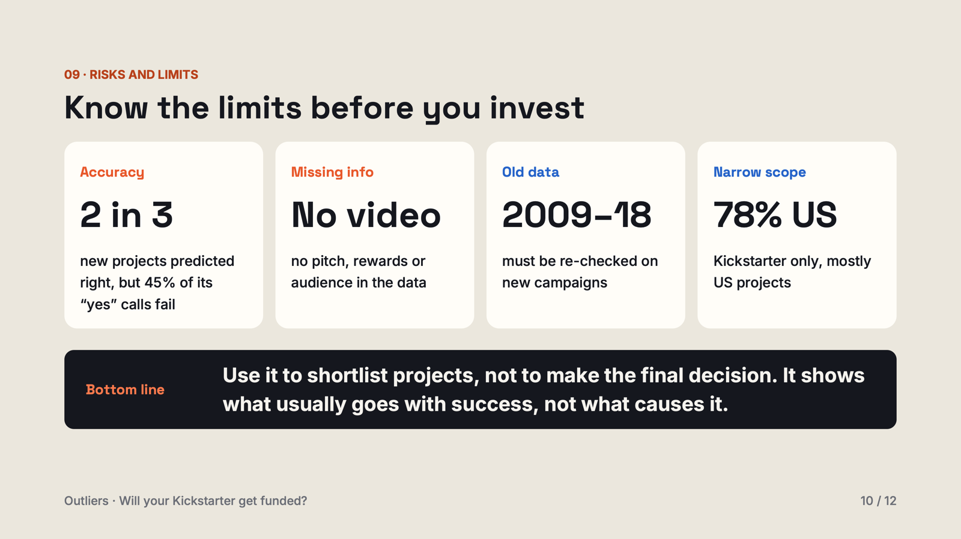

Slide 13
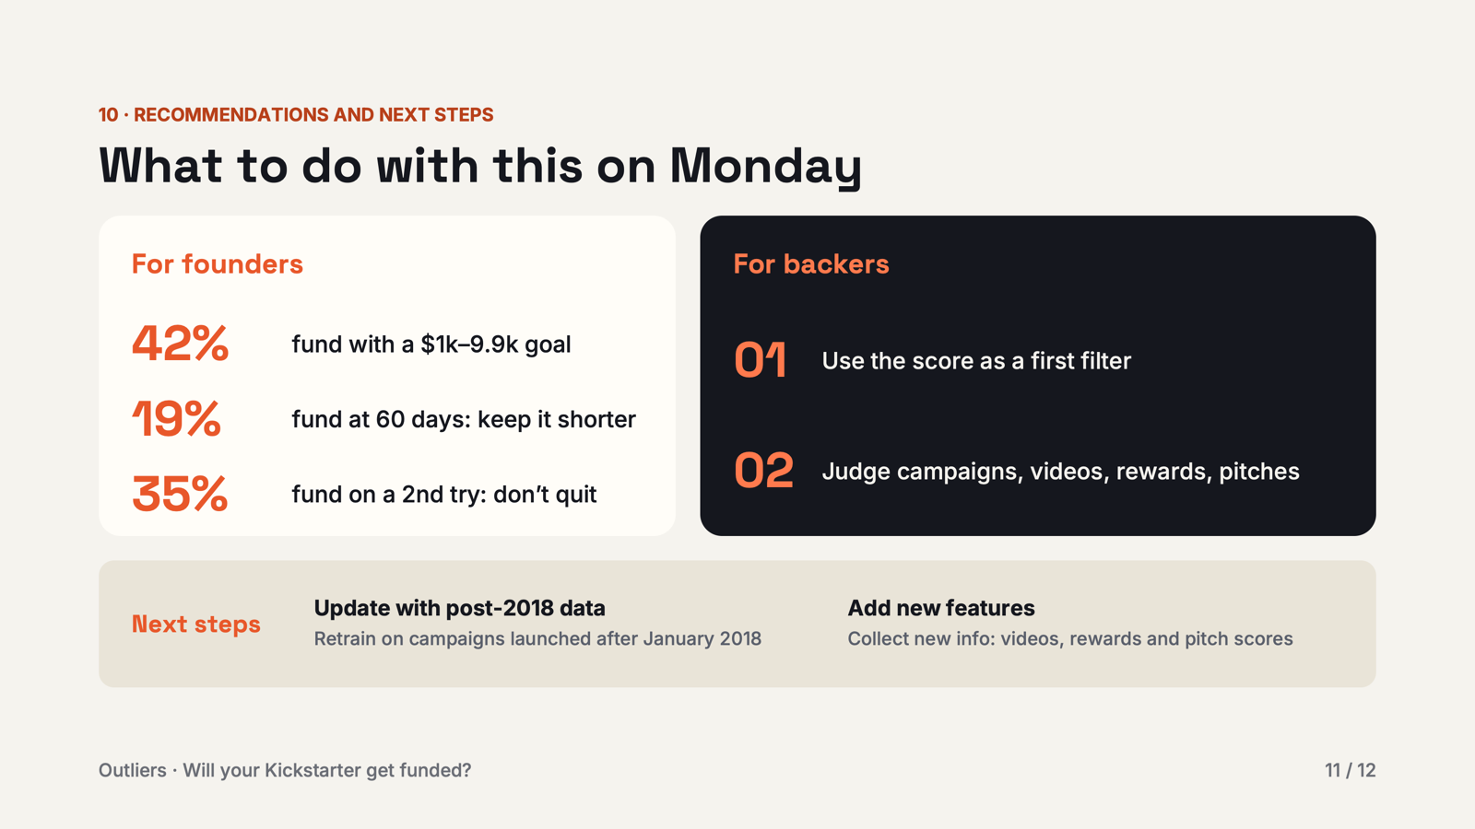

Slide 14
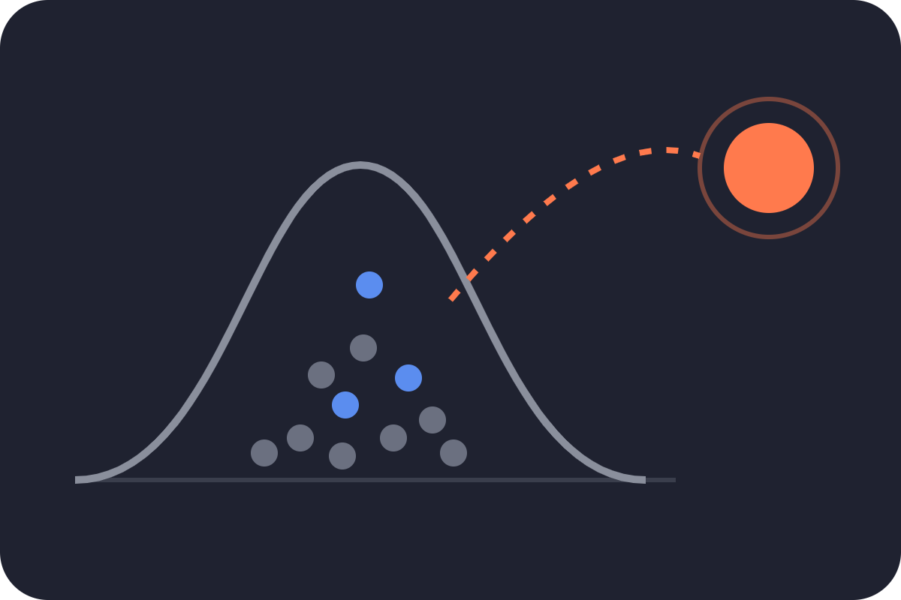
Thank you!
Questions, comments, or outliers? We’d love to hear them.
Outliers · Proudly two standard deviations from the mean
Notes:
Thank the audience and open the floor. Likely questions: how would this work on today's Kickstarter (answer: it needs re-validation on recent data); what would make it more accurate (text and campaign-page features); and is there a business here (the model is proven as a prototype; market size and pricing are still open questions).

